Slide 1
Machine Learning CSE - 403 Lecture - 04

Slide 2
Outline
Inductive Learning
Concept Learning
Hypothesis
Hypothesis Space
Null Hypothesis
Alternative Hypothesis
Null Hypothesis Testing
Find-S Algorithm

Slide 3
Inductive Learning
The inductive learning is based on formulating a generalized concept after observing a number of instances of examples of the concept.
It means the process of learning by example -- where a system tries to induce a general rule from a set of observed instances.
Most machine learning models learn using a type of inductive inference or inductive reasoning where general rules (the model) are learned from specific historical examples (the training data).

Slide 4
Concept Learning
The problem of searching through a predefined space of potential hypotheses for the hypothesis that best fits the training examples.
Much of human learning involves acquiring general concepts from past experiences. For an example, humans identify different vehicles among all the vehicles based on some specific set of features defined over a large set of features. This special set of features differentiates the subset of cars in the set of vehicles. This set of features that differentiate cars, can be called a concept.
Similarly, machines can also learn from the concepts to identify whether an object belongs to a specific category or not by processing past/training data to find a hypothesis that best fits the training examples.

Slide 5
What is a Hypothesis?
In most supervised machine learning algorithm, our main goal is to find out a possible hypothesis from the hypothesis space that could possibly map out the inputs to the proper outputs.
A hypothesis is a candidate model that approximates a target function for mapping examples of inputs to outputs
A hypothesis is a function that best describes the target in supervised machine learning.

Slide 6
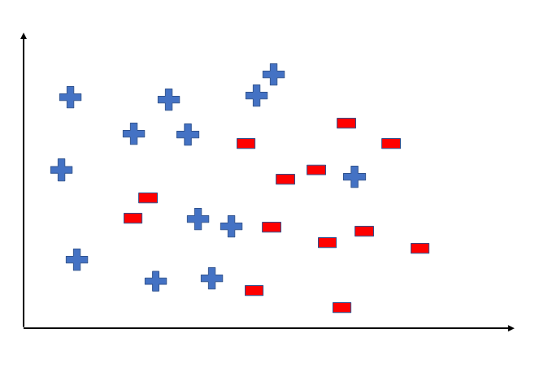
What is a Hypothesis?
To better understand the Hypothesis Space and Hypothesis consider the following coordinate that shows the distribution of some data:

Slide 7
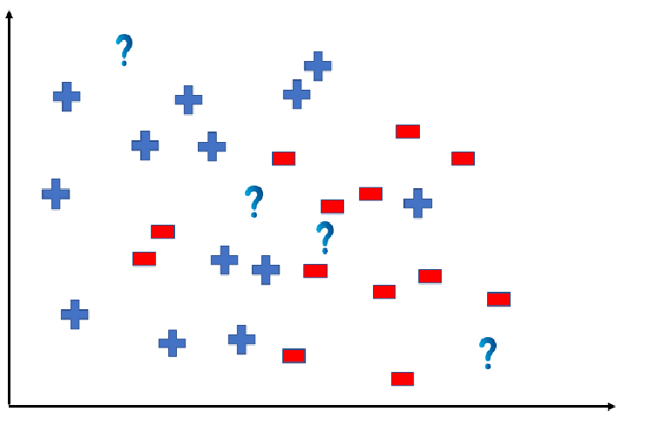
What is a Hypothesis?
Suppose we have test data for which we have to determine the outputs or results. The test data is as shown below:

Slide 8
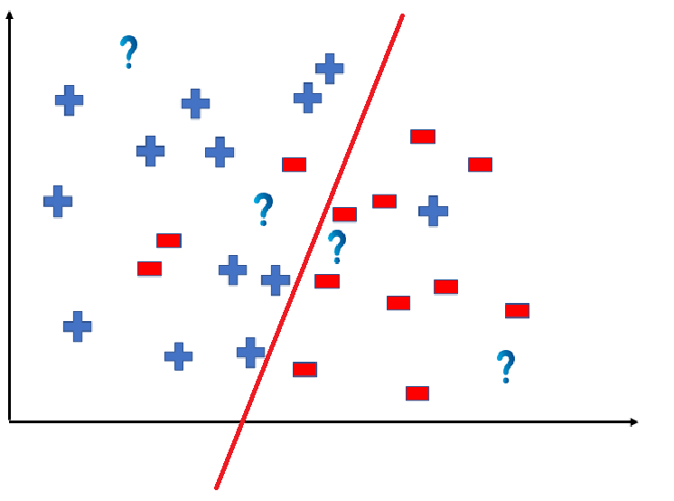
What is a Hypothesis?
We can predict the outcomes by dividing the coordinate as shown below:

Slide 9
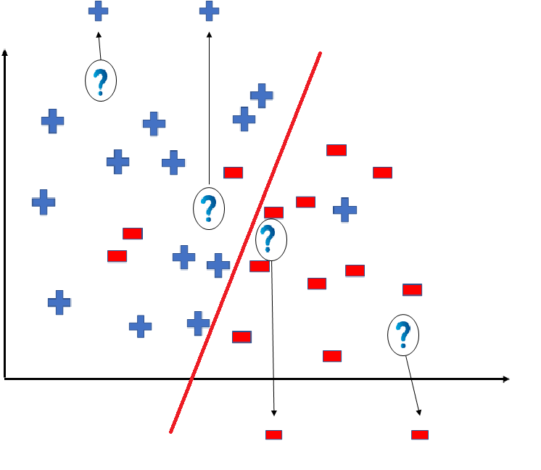
What is a Hypothesis?
So the test data would yield the following result:

Slide 10
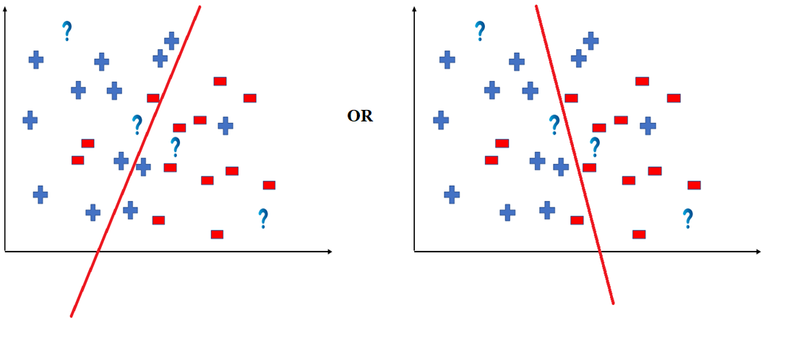
What is a Hypothesis?
But note here that we could have divided the coordinate plane as:

Slide 11
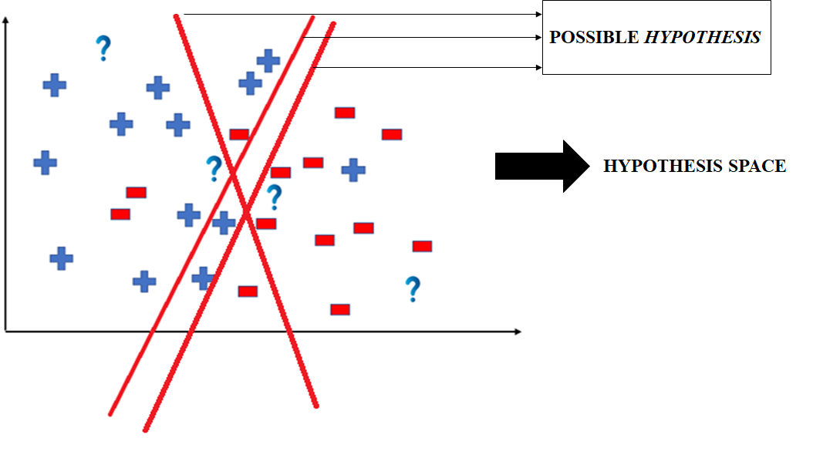
What is a Hypothesis?
The way in which the coordinate would be divided depends on the data, algorithm and constraints.
All these legal possible ways in which we can divide the coordinate plane to predict the outcome of the test data composes of the Hypothesis Space. Each individual possible way is known as the hypothesis.

Slide 12
Hypothesis Space
Hypothesis space is the set of all the possible legal hypothesis.
This is the set from which the machine learning algorithm would determine the best possible (only one) which would best describe the target function or the outputs.

Slide 13
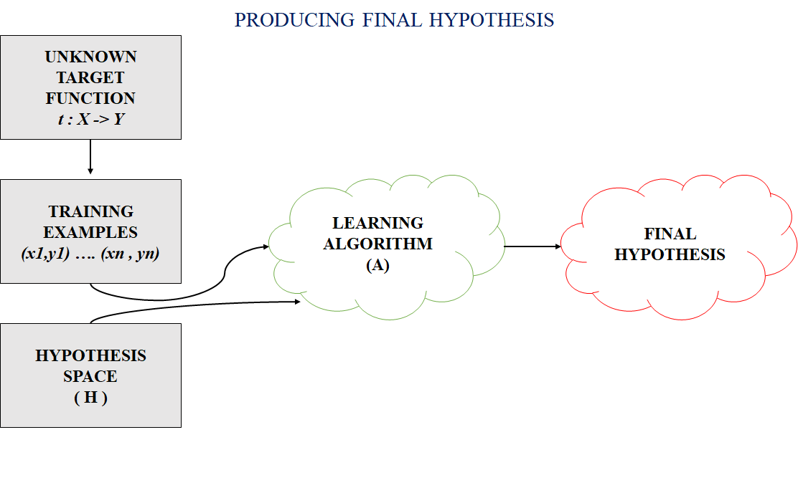
Final Hypothesis

Slide 14
Null Hypothesis
A null hypothesis is a hypothesis that says there is no statistical significance between the two variables in the hypothesis.
It is the hypothesis that the researcher is trying to disprove.
H is used to denote the set of all possible hypotheses that the learner may consider regarding the identity of the target concept.

Slide 15
Hypothesis
Each of the data objects represents a concept and hypotheses. Considering a hypothesis <true, true, false, false> is more specific because it can cover only one sample. To make a more generalized concept we can add some notations into this hypothesis. To this task we have following notations:
1. ⵁ (Represents a hypothesis which rejects all.)
2. < ? , ? , ? , ? > (Accepts all)
3. <true, false, ? , ? > (Accepts some)
The hypothesis ⵁ will reject all the data samples. The hypothesis <? , ? , ? , ? > will accept all the data samples. The ‘?’ notation indicates that the values of this specific feature do not affect the result.

Slide 16
General-to-Specific Learning
Most General Hypothesis: h = <?, ?, ?, ?, ?, ?>
Most Specific Hypothesis: h = < Ø, Ø, Ø, Ø, Ø, Ø>

Slide 17
General-to-Specific Ordering of Hypothesis
Many machine learning algorithms rely on the concept general-to-specific ordering of hypothesis.
h1 = < true, true, ?, ? >
h2 = < true, ? , ? , ? >
Any instance classified by h1 will also be classified by h2. So we can say that h2 is more general than h1. Using this concept we can find a general hypothesis that can be defined over entire data set X.

Slide 18
Find-S Algorithm: Finding Maximally Specific Hypothesis
Start with the most specific hypothesis from H and generalize this hypothesis each time it fails to classify and observed positive training data object as positive.
Step 1. The first step in Find-S algorithm is to start with most specific hypothesis that can be denoted by h <- <ⵁ, ⵁ, ⵁ, ⵁ>
Step 2. This step involves picking up next training sample and apply step 3 on the sample.
Step 3. The next step involves observing the data sample. If the sample is negative the hypothesis remains unchanged and we pick next training sample by processing step 2 again else we process step 4.
Step 4. If the sample is positive and we find that our initial hypothesis is too specific because it does not cover the current training sample then we need to update our current hypothesis. This can be done by the pairwise conjunction (Logical AND operation) of current hypothesis and training sample.

Slide 19
Find-S Algorithm: Finding Maximally Specific Hypothesis
If next training sample is <true, true, false, false> and current hypothesis is <ⵁ, ⵁ, ⵁ, ⵁ>, then we can directly replace our existing hypothesis with the new one.
If the next positive training sample is<true, true, false, true> and current hypothesis is <true, true, false, false> then we can perform a pairwise conjunctive AND with the current hypothesis and next training sample and find new hypothesis by putting ‘?’ in the place where the result of conjunction is false:
<true, true, false, true> ⴷ <true, true, false, false> = <true, true, false, ?>
Now we can replace our existing hypothesis with the new one:
h <-<true, true, false, ?>

Slide 20
Find-S Algorithm: Finding Maximally Specific Hypothesis
Step 5. This step involves repetition of step 2 till we have more training samples.
Step 6. Once there are no training samples the current hypothesis is the one we were trying to find. We can use the final hypothesis for classifying the real objects.

Slide 21
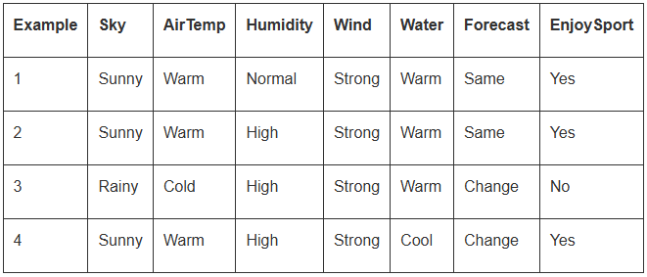

General-to-Specific Learning
h₂ is more general than h₁
h₂ imposes fewer constraints on the instance than h₁

Slide 22
Step 1: FIND-S
h0 = <Ø, Ø, Ø, Ø, Ø, Ø>

Slide 23
Step 2: FIND-S (Iteration-01)
h0 = <Ø, Ø, Ø, Ø, Ø, Ø>
a1
a2 a3 a4
a5 a6
x1 = <Sunny, Warm, Normal, Strong, Warm, Same>
Iteration 1
h1 = <Sunny, Warm, Normal, Strong, Warm, Same>

Slide 24
h1 = <Sunny, Warm, Normal, Strong, Warm, Same>
Step 2: FIND-S (Iteration-02)
Iteration 2
x2 = <Sunny, Warm, High, Strong, Warm, Same>
h2 = <Sunny, Warm, ?, Strong, Warm, Same>

Slide 25
Step 2: FIND-S (Iteration-03)
Iteration 3
Ignore
h3 = <Sunny, Warm, ?, Strong, Warm, Same>

Slide 26
h3 = < Sunny, Warm, ?, Strong, Warm, Same >
Step 2: FIND-S (Iteration-04)
Iteration 4
x4 = < Sunny, Warm, High, Strong, Cool, Change >
Step 3
Output
h4 = <Sunny, Warm, ?, Strong, ?, ?>

Slide 27
Limitation of Find-S
There's no way to determine if the only final hypothesis (found by Find-S) is consistent with the data or if there are more hypotheses that are consistent with data.
Inconsistent sets of training examples can mislead the Find-S algorithm, as it ignores negative data samples. An algorithm that can detect inconsistency of training data is better.
A good concept learning algorithm should be able to backtrack the choice of hypothesis found so that the resulting hypothesis can be improved over time. Unfortunately, Find-S provides no such method.

Slide 28
Example
Considering an example if a person goes to a movie or not based on 4 binary features with 2 values (true or false) possible:
1. Has Money -> <true, false>
2. Has Free Time -> <true, false>
3. It’s a Holiday -> <true, false>
4. Has Pending work -> <true, false>
And training data we have with two data objects as positive samples and one as negative:
x1: <true, true, false, false> : +ve
x2: <true, false, false, true> : +ve
x3: <true, false, false, true> : -ve

Slide 29
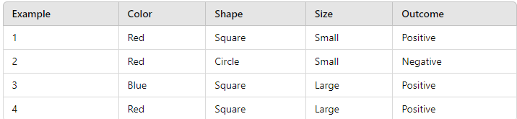
Task: Apply Find-S Algorithm to find out the final hypothesis

Slide 30
Thank You

